Slide 1
Application of Heap Data Structure
Priority Queues

Slide 2
Priority Queue
Priority Queue is similar to queue where we insert an element from the back and remove an element from front, but with a one difference that the logical order of elements in the priority queue depends on the priority of the elements.
The element with highest priority will be moved to the front of the queue and one with lowest priority will move to the back of the queue.
Thus it is possible that when you enqueue an element at the back in the queue, it can move to front because of its highest priority.

Slide 3
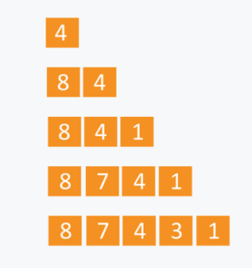
Example:
Let’s say we have an array of 5 elements : {4, 8, 1, 7, 3} and we have to insert all the elements in the max-priority queue.

Slide 4
Naive Approach:
Suppose we have N elements and we have to insert these elements in the priority queue.
We can use list and can insert elements in O(N) time and can sort them to maintain a priority queue in O(N logN ) time.
Efficient Approach:
We can use heaps to implement the priority queue.
It will take O(log N) time to insert and delete each element in the priority queue.
Based on heap structure, priority queue also has two types max- priority queue and min - priority queue.

Slide 5
Max Priority Queue is based on the structure of max heap and can perform following operations:
maximum(Arr) : It returns maximum element from the Arr. extract_maximum (Arr) - It removes and return the maximum element from the Arr. increase_val (Arr, i , val) - It increases the key of element stored at index i in Arr to new value val. insert_val (Arr, val ) - It inserts the element with value val in Arr.

Slide 6
Maximum :
int maximum(int Arr[ ])
{
return Arr[ 1 ];
//as the maximum element is the root element in the max heap.
}
Complexity: O(1)

Slide 7
Extract Maximum: In this operation, the maximum element will be returned and the last element of heap will be placed at index 1 and max_heapify will be performed on node 1 as placing last element on index 1 will violate the property of max-heap.
int extract_maximum (int Arr[ ])
{
if(length == 0)
{ cout<< “Can’t remove element as queue is empty”;
return -1;
}
int max = Arr[1];
Arr[1] = Arr[length];
length = length -1;
max_heapify(Arr, 1);
return max;
} Complexity: O(logN)

Slide 8
Increase Value: In case increasing value of any node, may violate the property of max-heap, so we will swap the parent’s value with the node’s value until we get a larger value on parent node.
void increase_value (int Arr[ ], int i, int val)
{
if(val < Arr[ i ])
{ cout<<”New value is less than current value, No need to
swap” <<endl;
return;
}
Arr[ i ] = val;
while( i > 1 and Arr[ i/2 ] < Arr[ i ]) // Bubble up
{ swap (Arr[ i/2 ], Arr[ i ]);
i = i/2;
}
} Complexity : O(log N)

Slide 9
Insert Value :
void insert_value (int Arr[ ], int val)
{
length = length + 1;
Arr[ length ] = -1;
//assuming all the numbers greater than 0 are to be inserted in queue.
increase_val (Arr, length, val);
}
Complexity: O(log N)

Slide 10
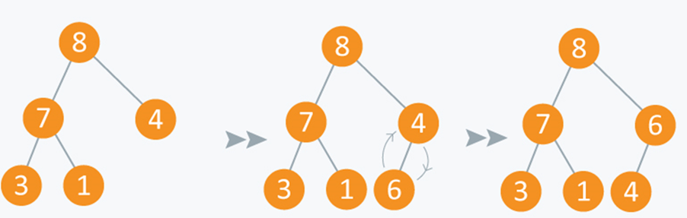
Example:
Initially there are 5 elements in priority queue. Operation: Insert Value(Arr, 6)

Slide 11
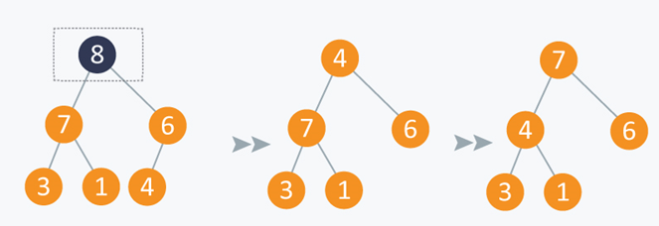
Operation: Extract Maximum:
In the diagram below, after removing 8 and placing 4 at node 1, violates the property of max-priority queue. So max_heapify(Arr, 1) will be performed which will maintain the property of max - priority queue.

Slide 12
As discussed above, like heaps we can use priority queues in scheduling of jobs.
When there are N jobs in queue, each having its own priority.
If the job with maximum priority will be completed first and will be removed from the queue, [we can use priority queue’s operation extract_maximum here].
If at every instant we have to add a new job in the queue, we can use insert_value operation as it will insert the element in O(log N) and will also maintain the property of max heap.

Slide 13
Now, let’s give you a problem to ponder on:
How will you perform below operations for min priority queue?
a. minimum (Arr) - return minimum element from Arr.
b. extract_minimum (Arr) - removes and returns minimum element from Arr.
c. decrease_value (Arr, i, val) - decrease value of element index at i in Arr to val. It is assumed that val is at least as small as current value of Arr[i].
d. insert_value (Arr, val) - insert value in Arr.

Slide 14
Wishing you all the Best

